Slide 1

Design and Simulation of 30 nm
NMOS and PMOS Devices Using TCAD
and Implementation of a 3-Bit Up Counter
in Cadence Virtuoso
Vignesh V (24BEC1520) | Tarun Siva M (24BEC1526) | Manish V (24BEC1515)
B.Tech – Electronics & Communication Engineering
SENSE, VIT Chennai | Guide: Dr. Girija Shanker Sahoo
April 2026

Slide 2
Presentation Outline
01
Introduction & Background
06
Logic Gate & Flip-Flop Design
02
Project Objectives
07
3-Bit Synchronous Up Counter
03
Methodology & Design Flow
08
Results & Discussion
04
TCAD Device Architecture (SDE + SDEVICE)
09
Propagation Delay Analysis
05
Compact Model Extraction & Cadence Setup
10
Conclusion & Future Work

Slide 3
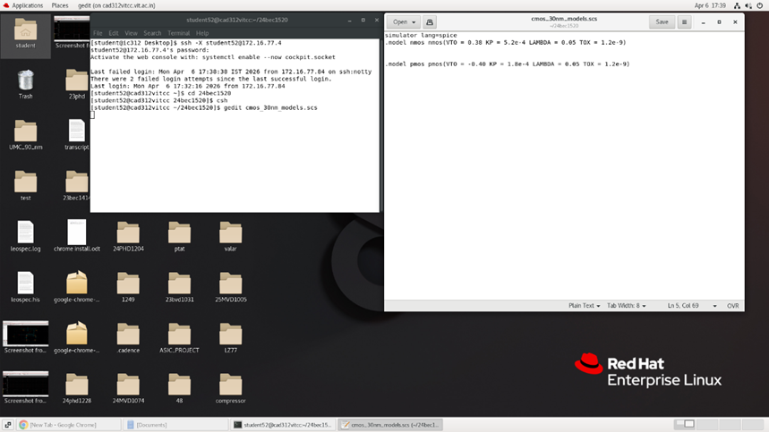
Introduction & Background
Motivation
Moore's Law drives transistor scaling into the nanoscale regime.
The 30 nm node offers higher integration density, faster switching, and lower power consumption.
Bridging device physics (TCAD) with circuit design (Cadence) is a critical industry workflow.
CMOS Technology at 30 nm
CMOS uses complementary NMOS + PMOS pairs for low static power.
Electron/hole mobility mismatch requires careful W/L sizing.
PMOS width ≈ 2.5× NMOS for symmetric switching.
Key 30 nm Challenges
Short Channel Effects (SCE) & Drain-Induced Barrier Lowering (DIBL)
Subthreshold leakage: transistor 'OFF' state is not perfectly non-conductive
Gate oxide reliability: oxide reduced to a few atomic layers

Slide 4
Project Objectives
01 Physical Device Synthesis
02 Electrical Characterization
03 Compact Model Extraction
Design 30 nm NMOS & PMOS in TCAD with correct doping profiles to suppress Short Channel Effects.
Perform Id–Vg & Id–Vd simulations to extract Vth, transconductance (Kp), and Ion/Ioff ratios.
Translate TCAD numerical data into a Spectre-compatible .scs model file for Cadence.
04 Logic Gate Validation
05 Circuit-Level Integration
06 Performance Evaluation
Implement CMOS Inverter in Cadence; verify Voltage Transfer Characteristic (VTC) symmetry.
Design & simulate a 3-bit Synchronous Up Counter using T-Flip Flops and the 30 nm models.
Conduct Transient Analysis: verify 000→111 binary counting and measure propagation delays.

Slide 5
Methodology & Design Flow
TCAD
Structure
Editor (SDE)
SDEVICE
Simulation
Parameter
Extraction
Spectre .scs
Model File
Cadence
Virtuoso ADE
3-Bit Up
Counter
Define geometry,
doping profiles,
mesh
Solve Drift-Diffusion
equations
Id–Vg, Id–Vd
Extract Vth, Kp, λ,
tox, Ion, Ioff
from data
Manual SPICE
model formatted
for Cadence
Import .scs,
build schematics,
run simulations
Gates → T-FF →
Counter → Verify
binary 000–111
Stage 1: Device Simulation
Stage 2: Circuit Simulation
Key Design Choices
▸ Gate Length (Lg) = 30 nm | Oxide Thickness (tox) = 1.2 nm | Substrate Doping = 1×10¹⁷ cm⁻³
▸ NMOS: P-type substrate + Arsenic S/D | PMOS: N-type substrate + Boron S/D (mirrored geometry)
▸ PMOS Width = 300 nm (2.5× NMOS = 120 nm) to compensate lower hole mobility
▸ Synchronous 3-bit counter: all 3 T-FFs share a common clock to eliminate ripple delay

Slide 6
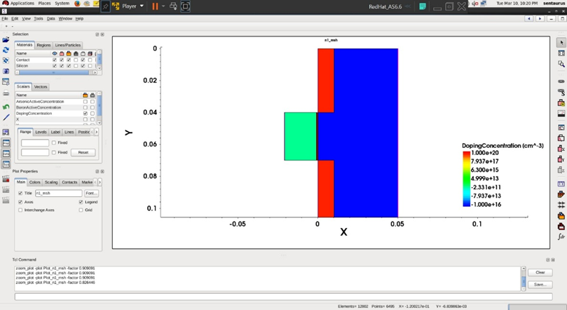
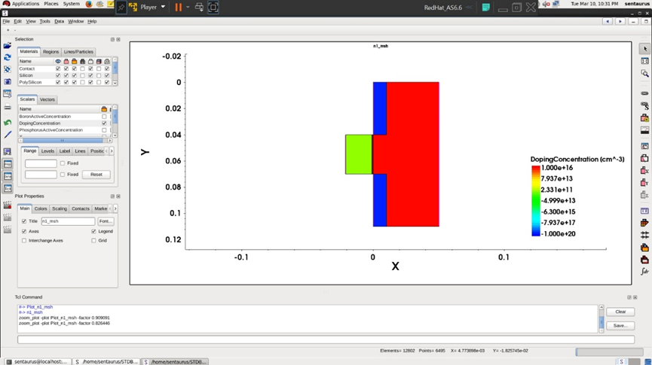
TCAD Device Architecture (SDE)
NMOS – Structure
PMOS – Structure
Substrate: P-type Silicon (Boron, 1×10¹⁷ cm⁻³)
Source/Drain: N-type (Arsenic, 1×10²⁰ cm⁻³)
Gate: Polysilicon, Lg = 30 nm
Oxide (SiO₂): tox = 1.2 nm
Substrate: N-type Silicon (Phosphorus, 1×10¹⁷ cm⁻³)
Source/Drain: P-type (Boron, 1×10²⁰ cm⁻³)
Gate: Polysilicon, Lg = 30 nm
Oxide (SiO₂): tox = 1.2 nm (mirrored geometry)

Slide 7
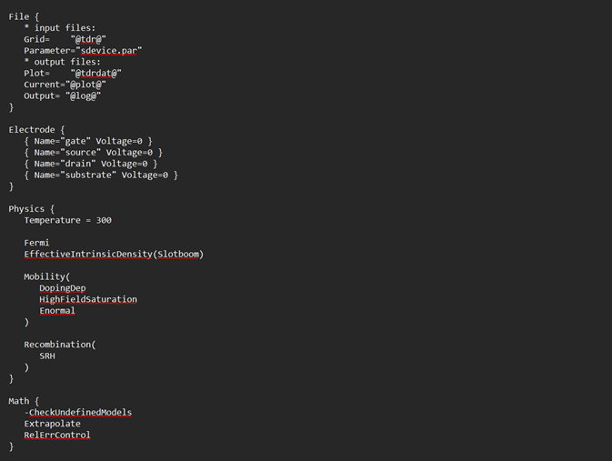
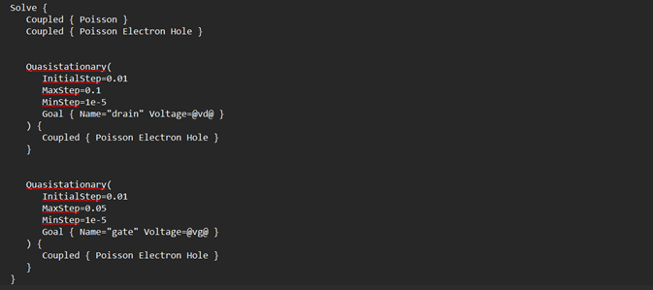
SDEVICE Simulation & Parameter Extraction
SDEVICE Configuration
Extracted Device Parameters (Table 1.1)
Physics models enabled:
Fermi-Dirac statistics for accurate carrier distribution
High-Field Saturation for velocity saturation at 30 nm
SRH recombination model
Solve sequence:
① Ramp Vd to operating Vdd → ② Sweep Vg (0→1V) for Id–Vg
Parameter | Symbol | NMOS | PMOS | Unit
Threshold Voltage | Vth | 0.38 | −0.40 | V
Transconductance | Kp | 5.2×10⁻⁴ | 1.8×10⁻⁴ | A/V²
Channel Length Mod. | λ | 0.05 | 0.05 | —
Oxide Thickness | tox | 1.2×10⁻⁹ | 1.2×10⁻⁹ | m
ON Current | Ion | 1×10⁻⁴ | 3.2×10⁻⁵ | A
OFF Current | Ioff | 1×10⁻⁶ | 1×10⁻⁶ | A

Slide 8
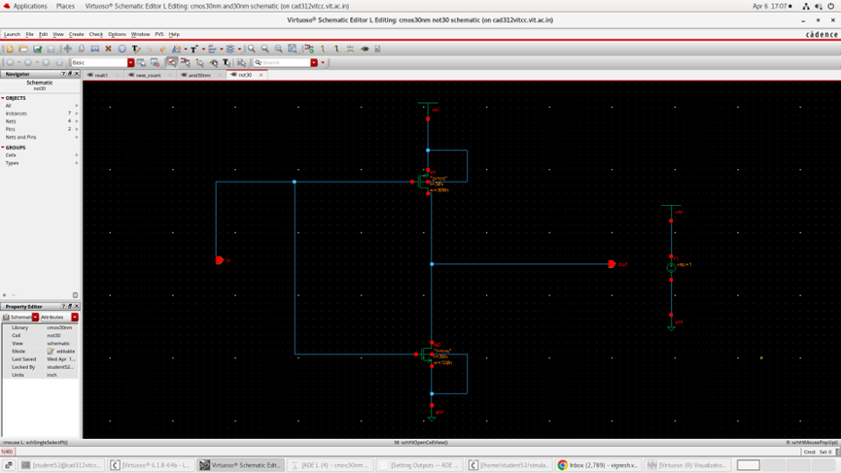
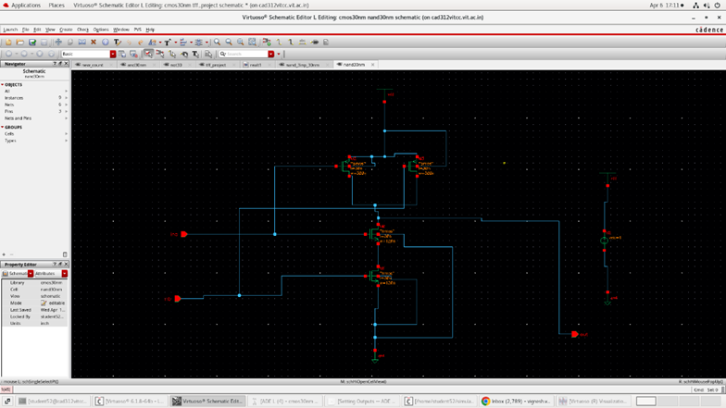
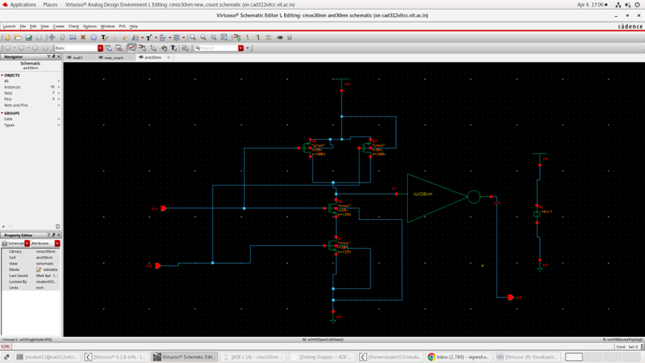
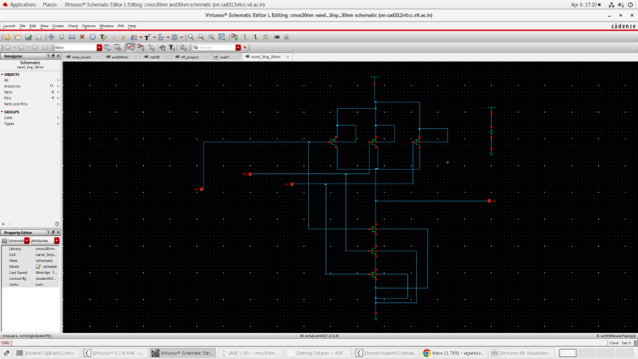
Modular Logic Gate Design in Cadence
CMOS Inverter (NOT)
NAND Gates (2 & 3 input)
AND Gate (2 input)
▸ Basic building block of all logic
▸ Universal gates forming flip-flop internals
▸ NAND + Inverter combination
▸ Wp = 300 nm, Wn = 120 nm (ratio 2.5:1)
▸ Series NMOS pull-down network
▸ Used for counter enable logic
▸ Sized for symmetric VTC: Vout switches at Vdd/2
▸ Parallel PMOS pull-up network
▸ Bit-1 toggles when Q0 = High
▸ Both 2-input and 3-input variants built
▸ Bit-2 toggles when Q0 AND Q1 = High

Slide 9
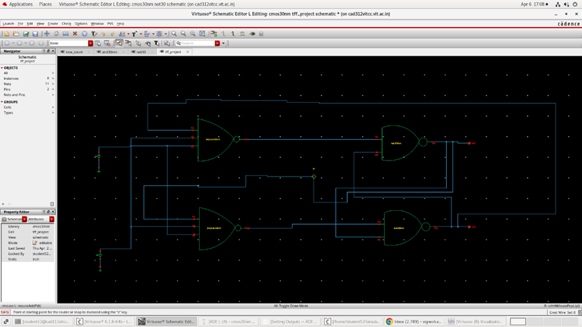
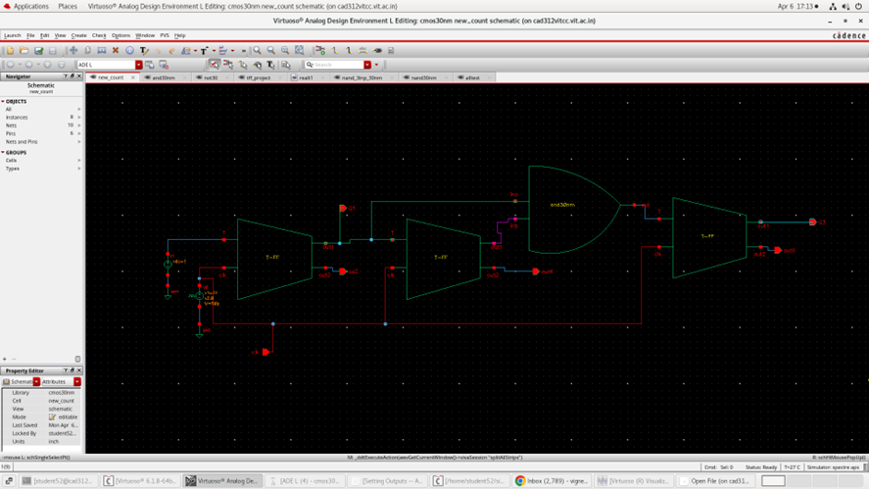
T-Flip Flop Architecture & 3-Bit Counter Integration
T-Flip Flop (Toggle FF)
3-Bit Synchronous Up Counter
Bit | Stage | Toggle Condition
Q0 (LSB) | 1st T-FF | Always (T tied to Vdd)
Q1 | 2nd T-FF | When Q0 = High
Q2 (MSB) | 3rd T-FF | When Q0 AND Q1 = High
Internal structure: Cross-coupled NAND gates + Inverters (master-slave)
Toggle behavior: Q flips at every rising edge of CLK
30 nm integration: Each gate uses custom .scs TCAD models
Tested at: 100 MHz clock frequency — no glitches or races observed
Synchronous design: All 3 flip-flops share a single common clock input, eliminating ripple (race) delays present in asynchronous (ripple) counters.

Slide 10
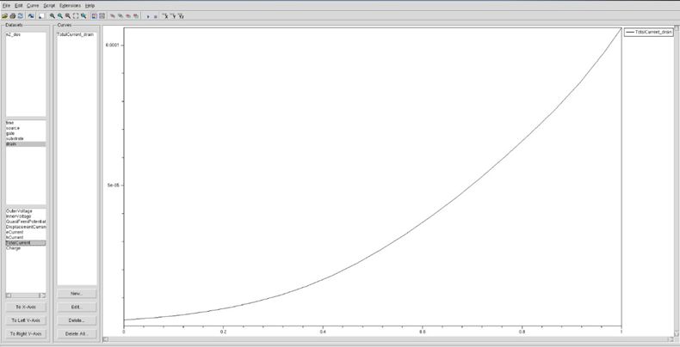
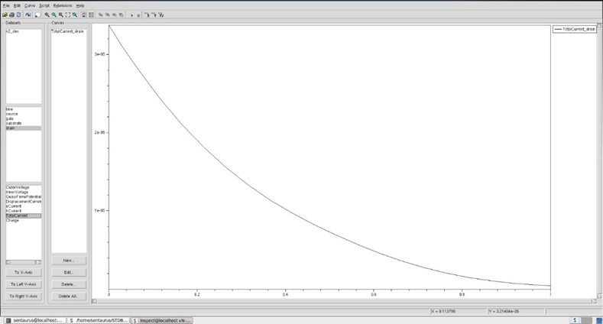
Results – TCAD Device Characteristics
Id – Vg Characteristics
Key Findings
NMOS Vth
0.38 V
PMOS Vth
−0.40 V
NMOS Ion
1×10⁻⁴ A
PMOS Ion
3.2×10⁻⁵ A
Ion/Ioff
100× (both)
▸ Minor DIBL effect observed — remains within acceptable limits for digital switching at 30 nm.

Slide 11
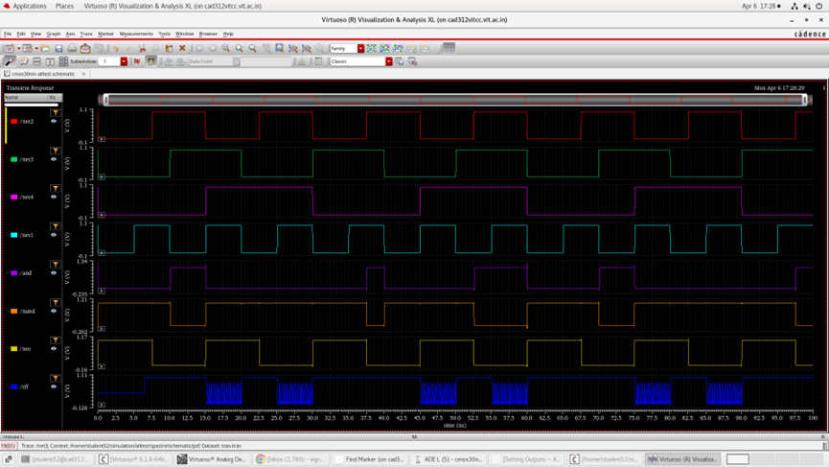
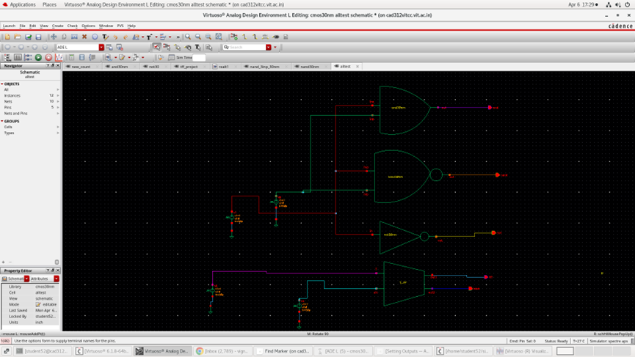
Results – CMOS Gate Performance (Transient Analysis)
All gates use the custom 30 nm .scs TCAD-extracted models. Waveforms confirm correct logic behavior for NOT, 2-input NAND, 3-input NAND, and AND gates.

Slide 12
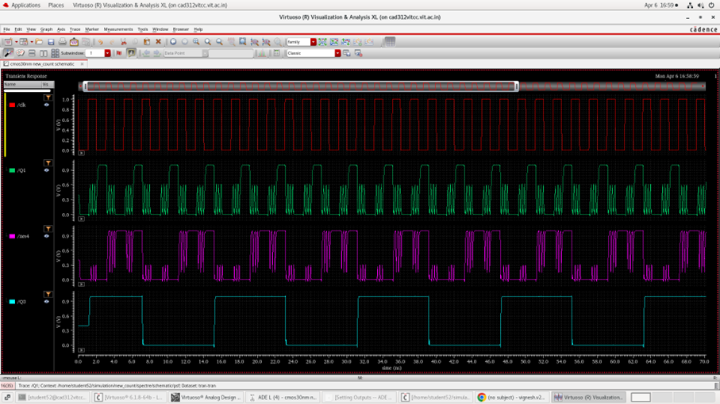
Results – 3-Bit Synchronous Up Counter Output
Binary Count Sequence
Test Conditions
000 → 001 → 010 → 011 → 100 → 101 → 110 → 111 → 000 (repeats)
Clock Frequency: 100 MHz | Supply Voltage (Vdd): 1 V
Simulation Type: Transient Analysis (multiple clock cycles)
Outcome: Correct binary progression 000→111 — no glitches or race conditions.
Q0 (LSB) toggles every cycle | Q1 toggles every 2 cycles | Q2 (MSB) every 4 cycles

Slide 13
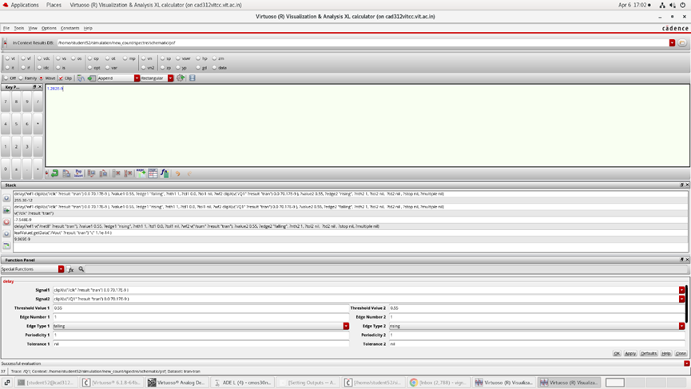
Propagation Delay Analysis
1.282 ns
~780 MHz
Theoretical Max Frequency (fmax)
Avg. Propagation Delay (Tpd)
Propagation Delay per Counter Stage (Table 1.2)
Output Signal | Logic Stage | Tpd
Q0 (LSB) | 1st T-FF | 1.2 ns
Q1 | 2nd T-FF | 2.1 ns
Q2 (MSB) | 3rd T-FF | 3.3 ns
Each stage adds cumulative delay → cascade design must account for setup time constraints.
fmax = 1 / Tpd = 1 / (1.282 × 10⁻⁹) ≈ 780 MHz

Slide 14
Conclusion
◆
Device Level
Robust 30 nm NMOS & PMOS synthesized in Sentaurus TCAD. Correct doping + thin tox suppressed Short Channel Effects (SCE).
◆
Model Extraction
Physical data accurately translated into Spectre (.scs) model files — seamlessly integrated into Cadence Virtuoso ADE.
◆
Circuit Level
CMOS Inverter VTC verified. 3-bit Synchronous Up Counter confirmed correct 000→111 binary sequence at 100 MHz.
◆
Performance
Propagation delay Tpd = 1.282 ns → theoretical fmax ≈ 780 MHz. Confirms 30 nm planar MOSFETs deliver high-speed switching.
"This project confirms that 30 nm planar MOSFETs, when properly modelled, offer the high-speed switching and density required for modern integrated systems."

Slide 15
Future Work
01 Layout & Parasitic Extraction (PEX)
02 FinFET Implementation
Create physical GDSII layout. Analyse interconnect resistance and parasitic capacitance impact on maximum clock frequency.
Model a 3D FinFET in TCAD at sub-30 nm. Compare Ion/Ioff ratio and subthreshold swing against the current planar model.
03 Power & Thermal Analysis
04 Monte Carlo Simulations
Detailed study of static power dissipation and thermal gradients across the counter during high-frequency operation.
Account for manufacturing tolerances — analyse how Vth and oxide thickness variations affect 3-bit counting reliability.

Slide 16
References
[1] Auth & Plummer (1997). Scaling theory for cylindrical, fully-depleted, surrounding-gate MOSFETs. IEEE Electron Device Letters, 18(2), 74–76.
[2] Hsu & Wang (2012). High-speed low-power synchronous counter using 30 nm CMOS. IEEE ISCAS Proceedings, 114–117.
[3] Rabaey, Chandrakasan & Nikolić (2003). Digital Integrated Circuits: A Design Perspective (2nd ed.). Pearson Education.
[4] Synopsys, Inc. (2024). Sentaurus™ Device Simulation User Guide, Version V2023.12.
[5] Weste & Harris (2011). CMOS VLSI Design: A Circuits and Systems Perspective (4th ed.). Pearson Education.
Thank You
Vignesh V | Tarun Siva M | Manish V
Guide: Dr. Girija Shanker Sahoo | SENSE, VIT Chennai

